Slide 1


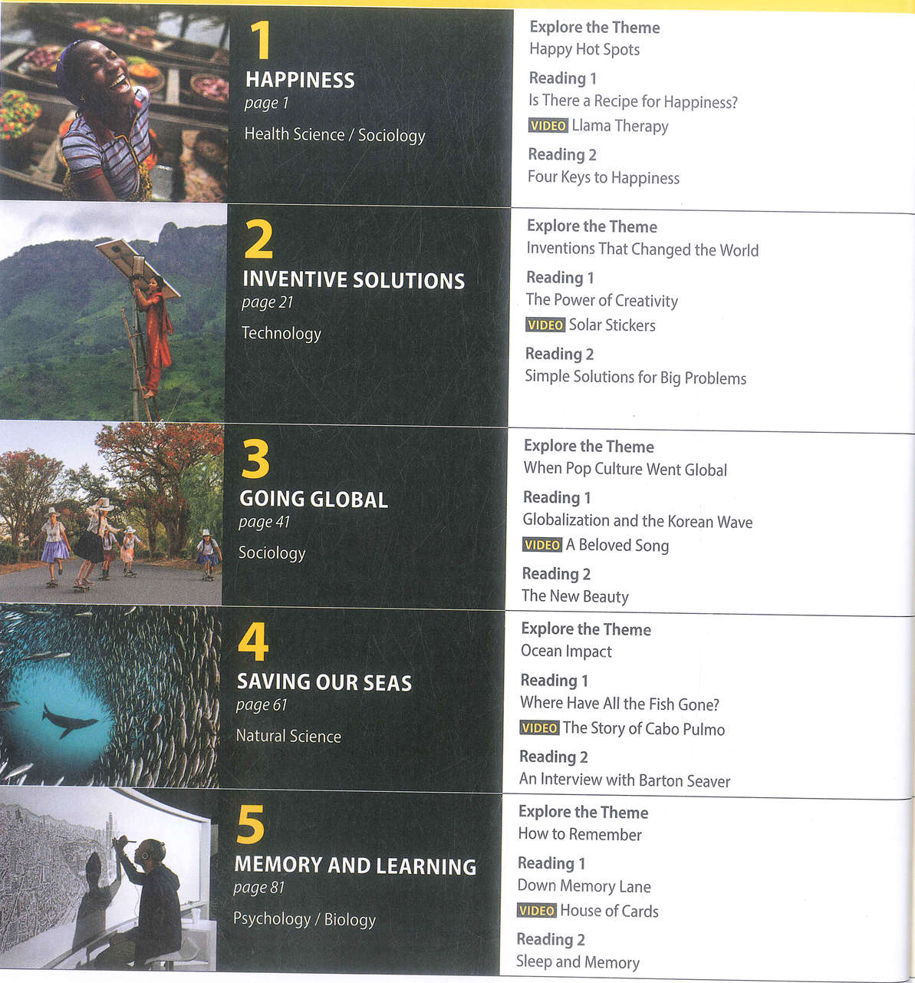
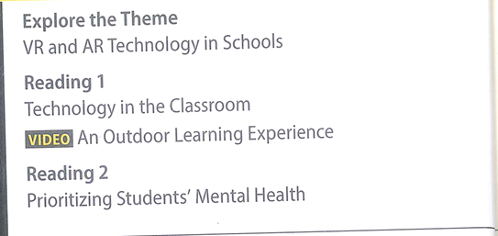
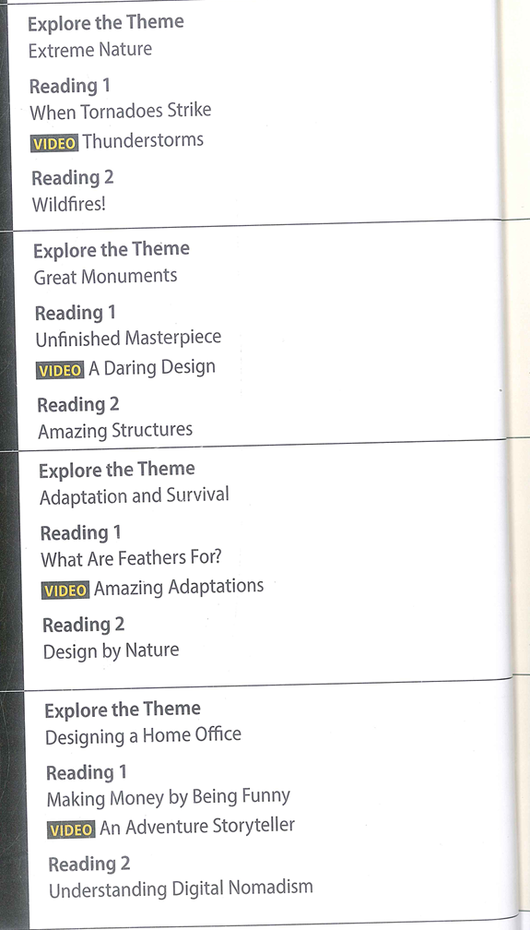
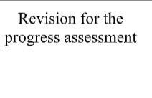
Syllabus

Slide 2
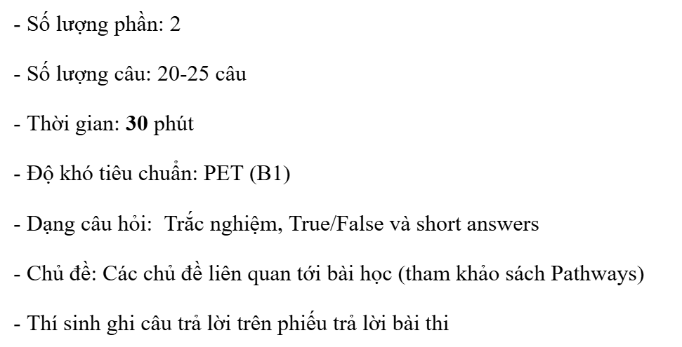
Mark allocation
Participation : 10%
Midcourse test : 30%
Final test: 60%

Slide 3
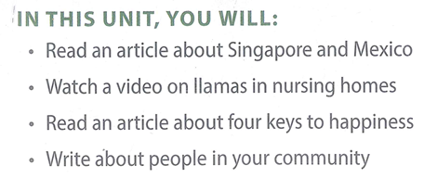
Unit 1 happiness

Slide 4
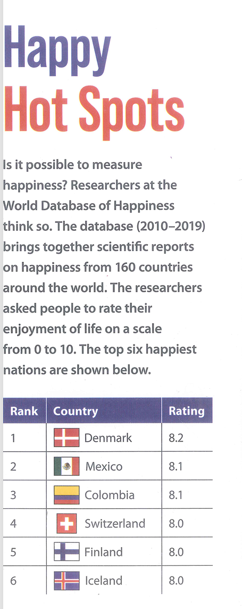
Lead – in
Measure happiness
Database /ˈdeɪ.tə.beɪs/: an organized set of data that is stored in a computer and can be looked at and used in various ways
Scientific report
Rate sth on a scale from … to….

Slide 5
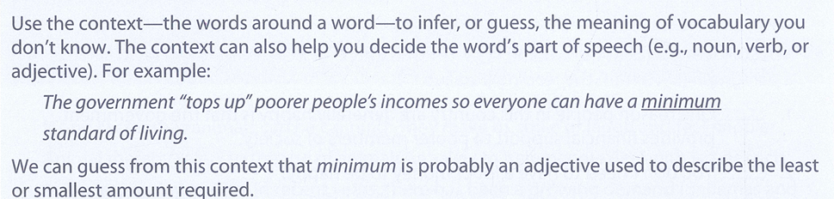
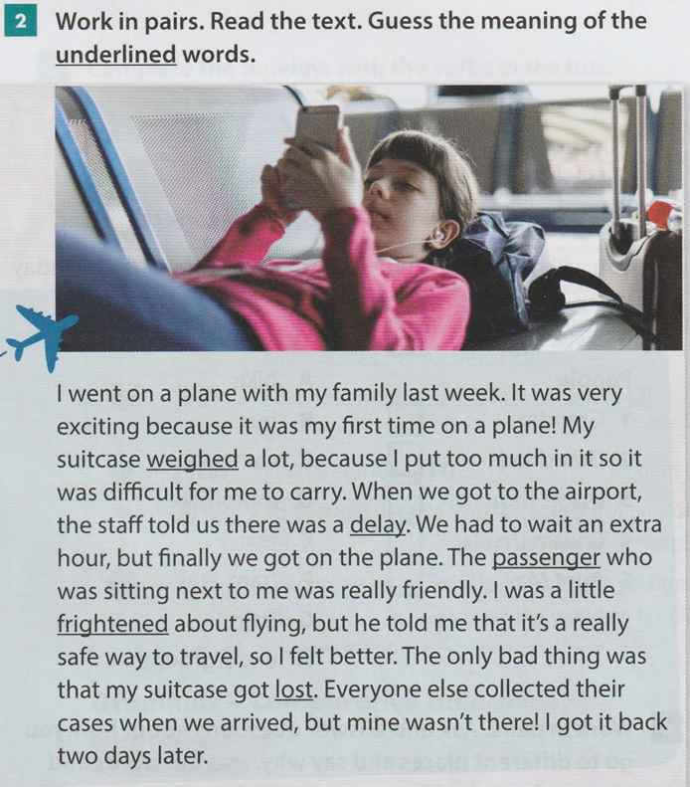
Reading skill 1 – inferring meaning from context (p. 7)

Slide 6
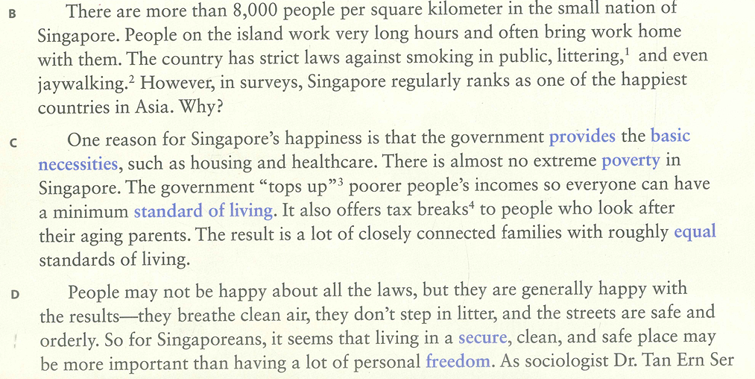
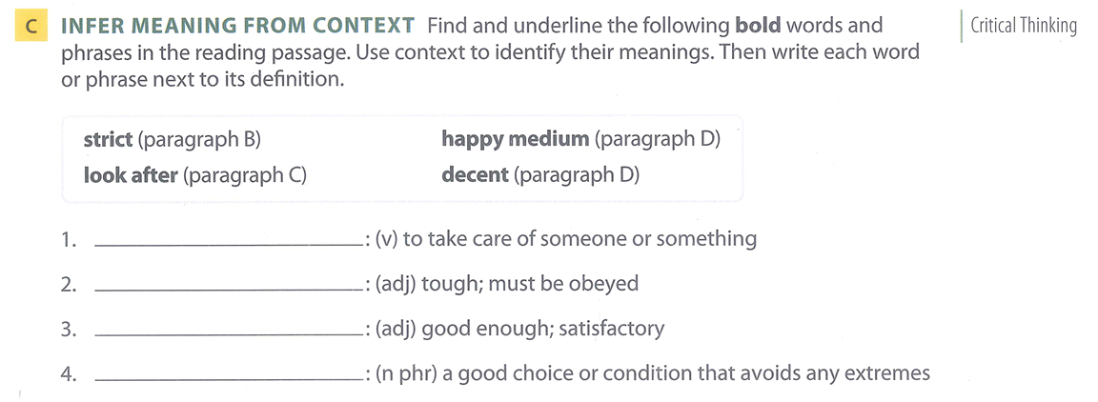
Practice 1
(Page 7)
Look after
strict
decent
Happy medium

Slide 7

Reading skill 2 – identifying the main idea (p. 8)
The main idea of a paragraph is the most important idea, or the idea that the paragraph is about. A good paragraph has one main idea and one or more supporting ideas. Read the paragraph below and think about its main idea.
Researchers have found that the sunny weather in Mexico is one of the reasons that people there are happy. Mexico has many hours of sunlight, so people in Mexico get a lot of vitamin D. Vitamin D is important for overall health and well-being. Also, studies show that when people tan, they make more endorphins, chemicals in our bodies that make us feel happy.
Which of these statements is the main idea of the paragraph?
a. People in Mexico are happy because they get a lot of vitamin D.
b. Tanning helps us create more endorphins, which make us feel happy.
c. Mexico gets a lot of sun, which may make people there happier.
The last sentence is the main idea. The other two sentences are supporting ideas that explain the main idea.

Slide 8
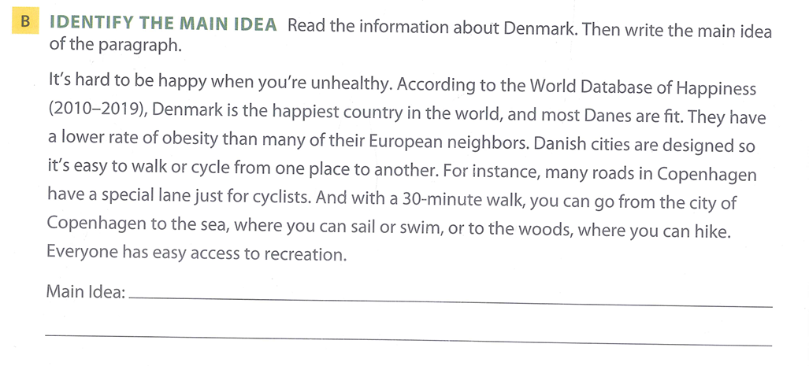


Practice 2
Topic – controlling idea – supporting details.
Page 8
In Denmark, people can easily walk or cycle from one place to another, so they can stay fit and be happier

Slide 9
Reading 1 – group work
Vocabulary : A & B page 4
Reading:
Main ideas: A page 8 – reading passage page 5, 6
Comprehension: A & B, page 5, 6, 7

Slide 10
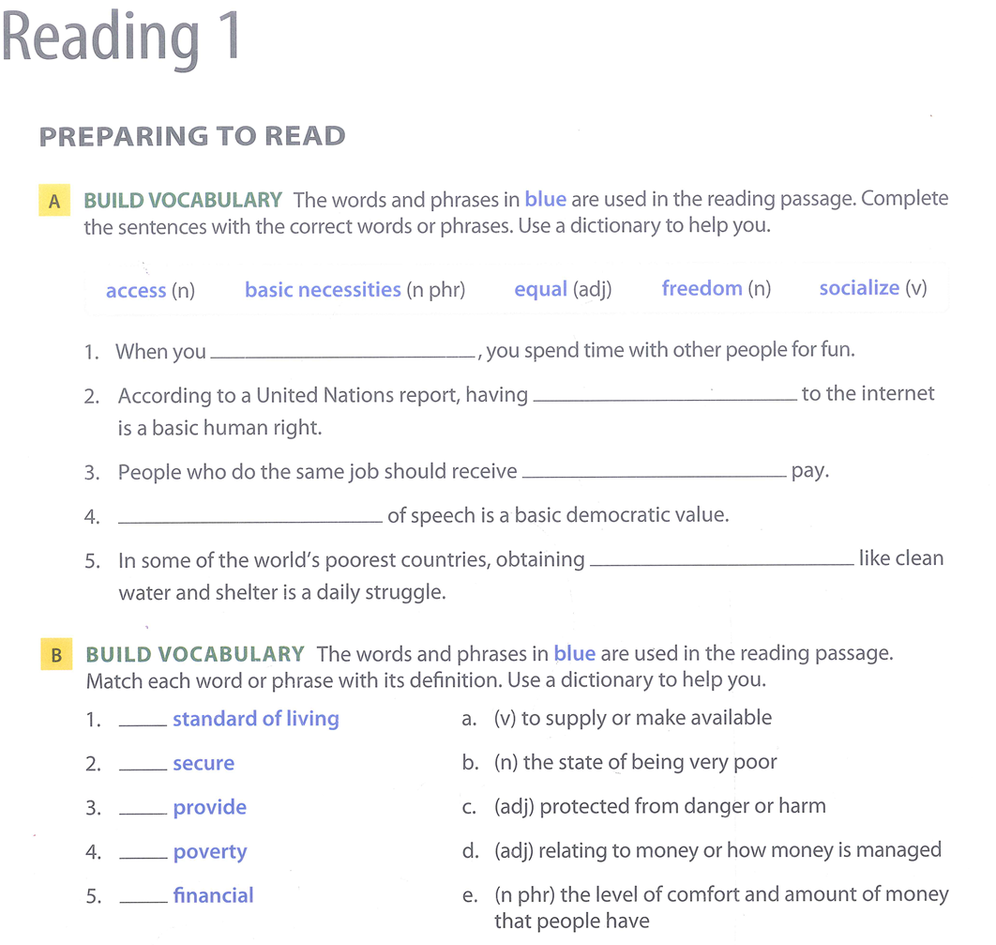
Reading 1. vocabulary development
Pay: the money that somebody gets for doing regular work
Payment: the act of paying somebody/something
socialize
Democratic /ˌdeməˈkrætɪk/: based on the principle that all members have an equal right to be involved in running an organization
Obtain /əbˈteɪn/: to get something, especially by making an effort
Struggle: a hard fight in which people try to obtain or achieve something
access
equal
Freedom
Basic necessities
/nəˈsesəti/
e
c
a
b
d

Slide 11
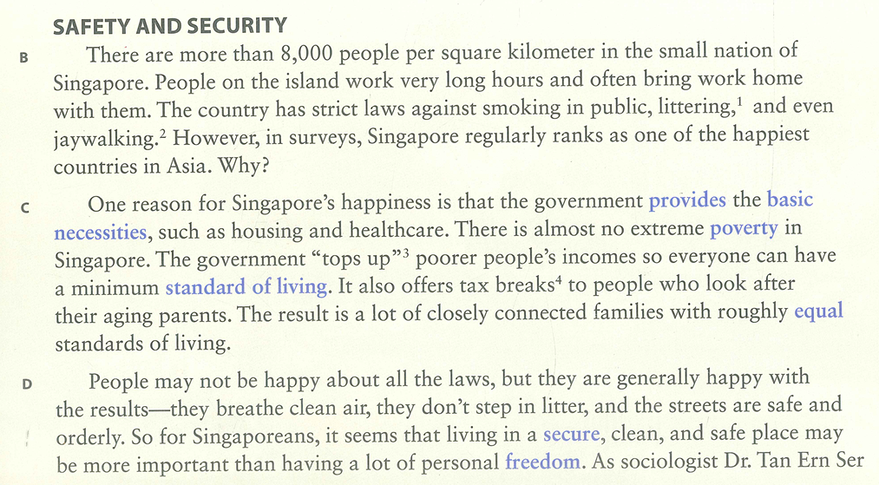
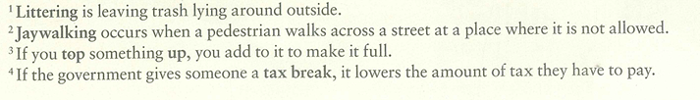
Reading 1. main ideas
A. MATCH Look back at the reading passage on pages 5–6. Match each main idea below with a paragraph (B–H) from the reading passage.
_____ One reason people in this country are generally happy is that the government provides financial support to poorer members of society.
_____ You don’t need to have a lot of money to be happy.
_____ Spending time with family and friends can contribute to happiness.
_____ There are different answers to the question, “What makes people happy?”
_____ Most people in this country are willing to give up certain freedoms to gain more safety and stability.
Page 8

Slide 12
Reading 1. main ideas
A. MATCH Look back at the reading passage on pages 5–6. Match each main idea below with a paragraph (B–H) from the reading passage.
_____ One reason people in this country are generally happy is that the government provides financial support to poorer members of society.
_____ You don’t need to have a lot of money to be happy.
_____ Spending time with family and friends can contribute to happiness.
_____ There are different answers to the question, “What makes people happy?”
_____ Most people in this country are willing to give up certain freedoms to gain more safety and stability.
Page 8
C
D

Slide 13
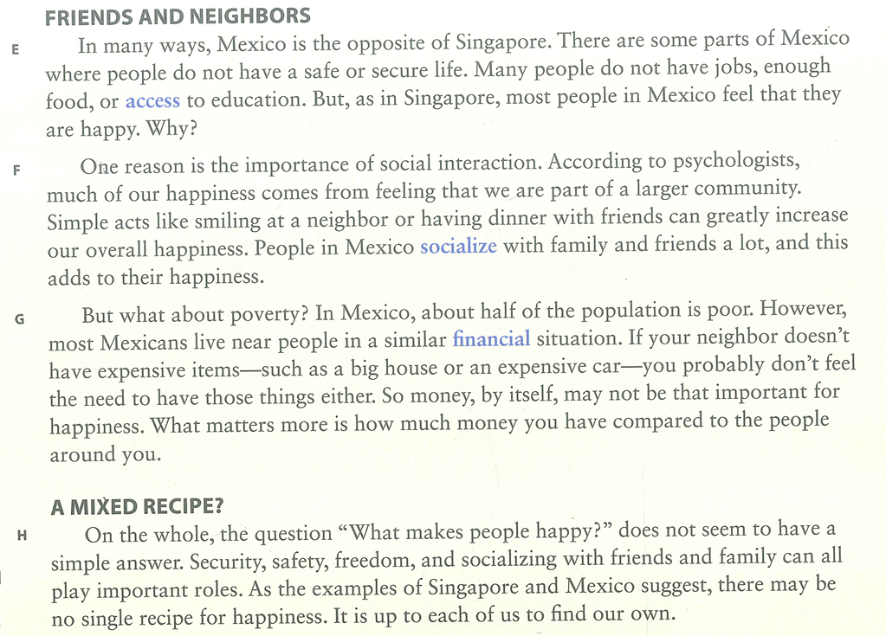
Reading 1. main ideas
A. MATCH Look back at the reading passage on pages 5–6. Match each main idea below with a paragraph (B–H) from the reading passage.
_____ One reason people in this country are generally happy is that the government provides financial support to poorer members of society.
_____ You don’t need to have a lot of money to be happy.
_____ Spending time with family and friends can contribute to happiness.
_____ There are different answers to the question, “What makes people happy?”
_____ Most people in this country are willing to give up certain freedoms to gain more safety and stability.
Page 8
C
G
F
H
D

Slide 14
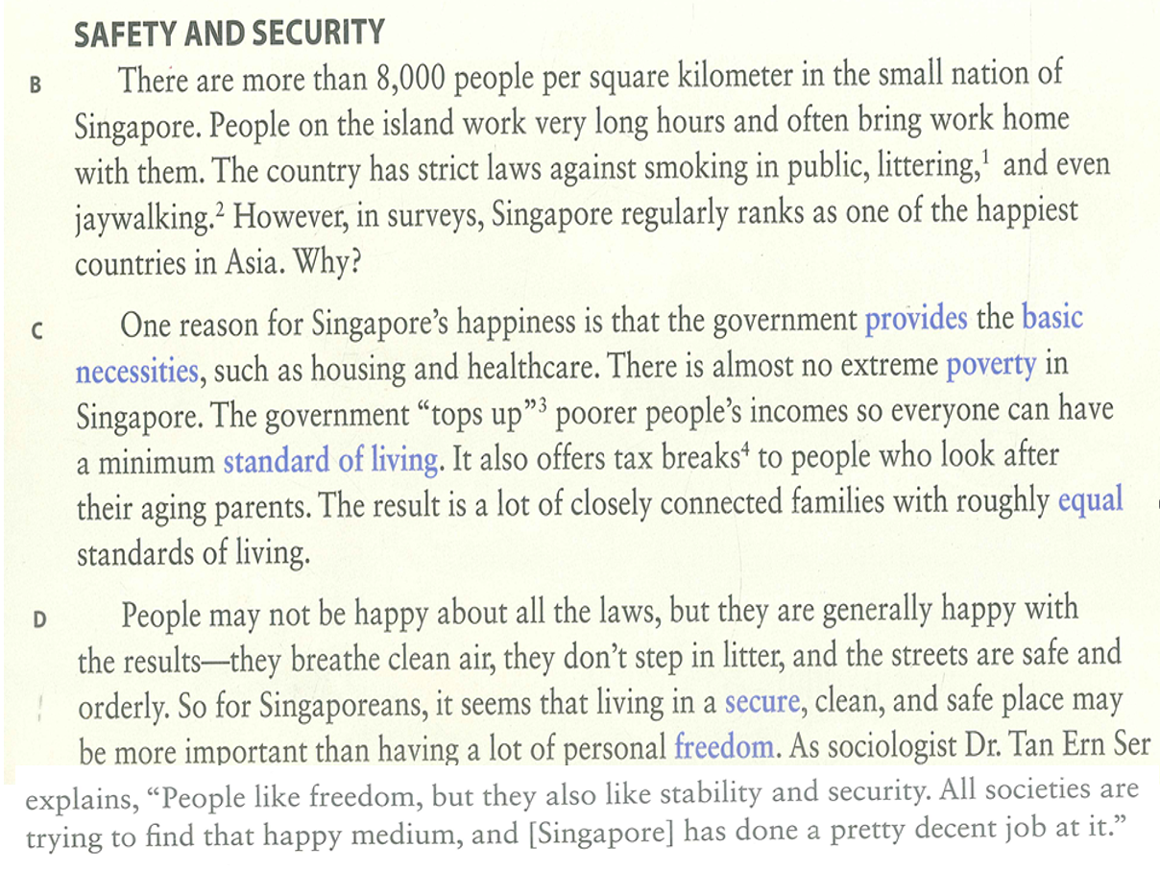


Reading 1. reading comprehension

Slide 15
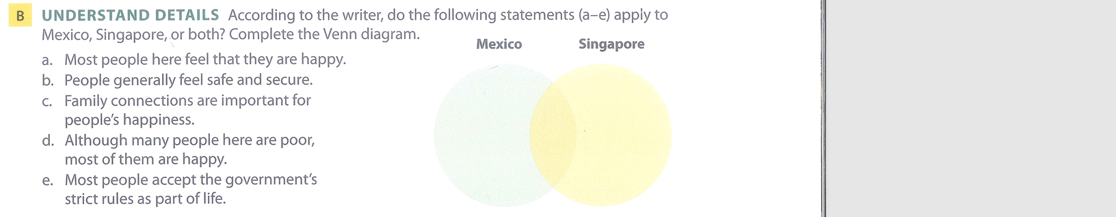
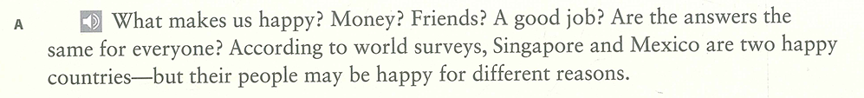
Reading 1. reading comprehension
Both
Singapore
Both
Mexico
Singapore

Slide 16
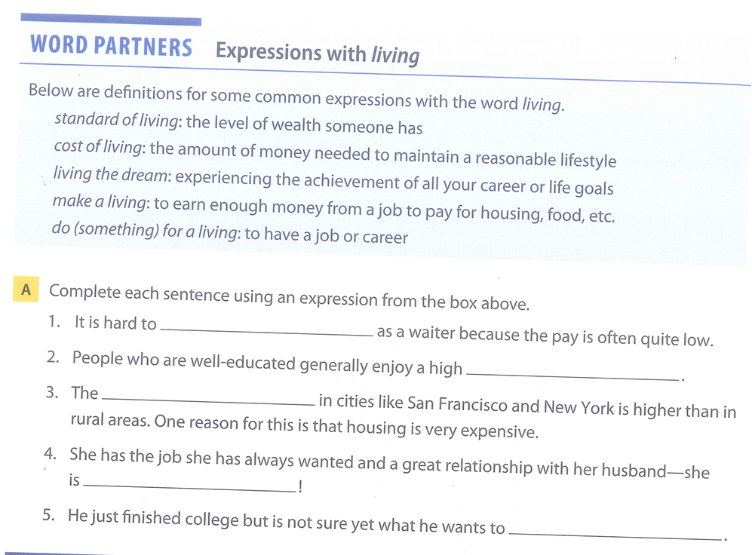
Vocabulary extension – word partners
Page 14
Make a living
Standard of living
Cost of living
Living the dream
Do for a living

Slide 17
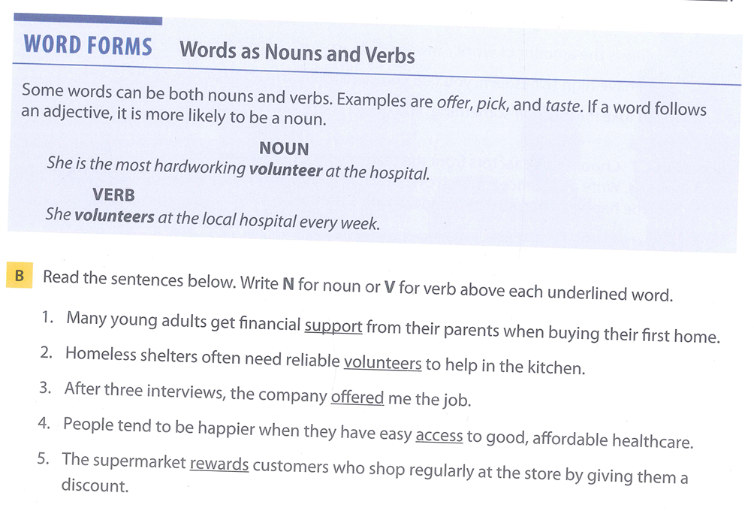
Vocabulary extension – word forms
Page 14

Slide 18
Reading 2 – work in pair
Vocabulary – A page 10
Reading – A, B, C page 11 - 13

Slide 19
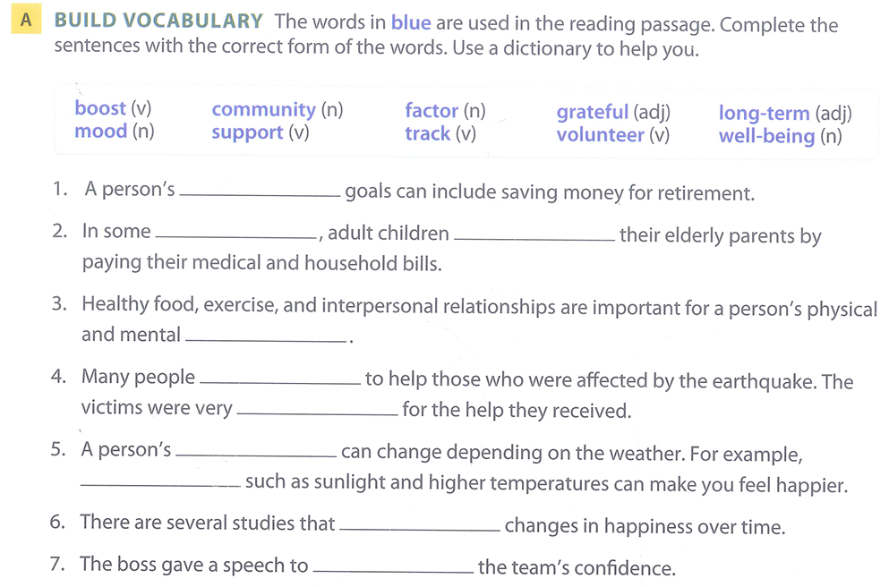
Reading 2 – vocabulary
Long-term
Retirement
Interpersonal AND intrapersonal
(btw ppl) (within person’s mind)
Well-being: general health & happiness
Temperature /ˈtem.prə.tʃər/
Boost one’s confidence
communities
support
Well-being
volunteered
grateful
mood
factors
track
boost

Slide 20
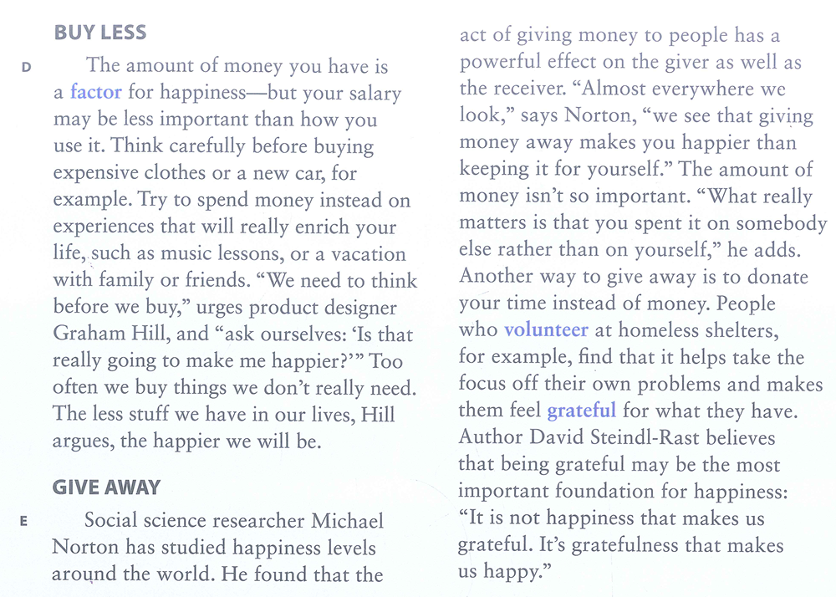
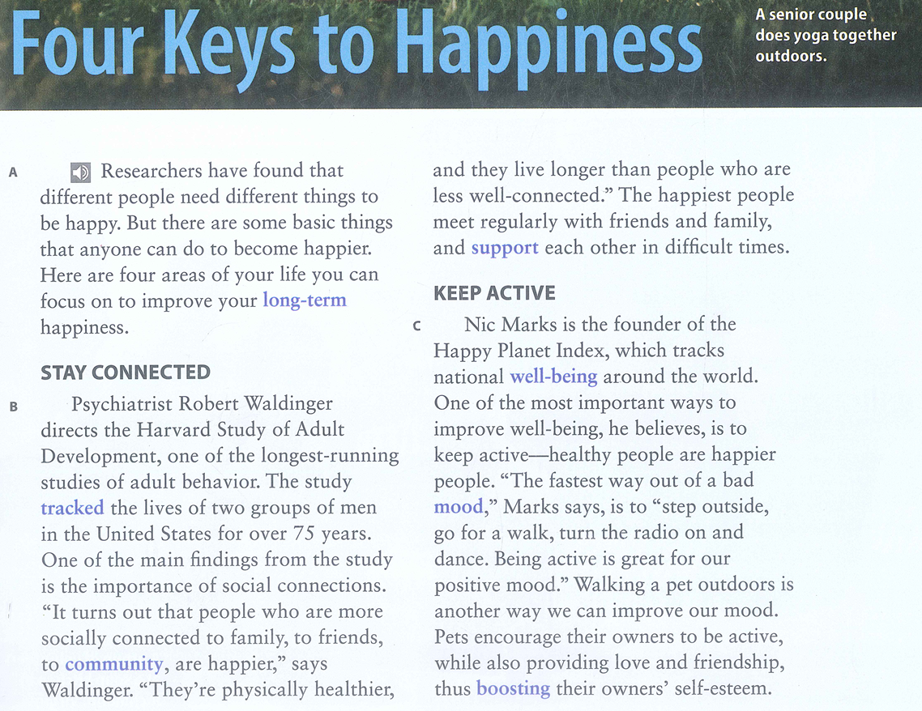
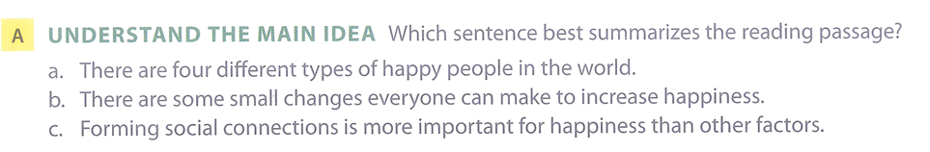

Reading 2 – main ideas

Slide 21
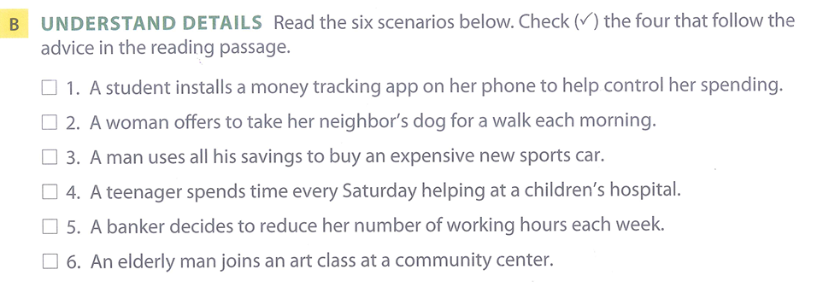
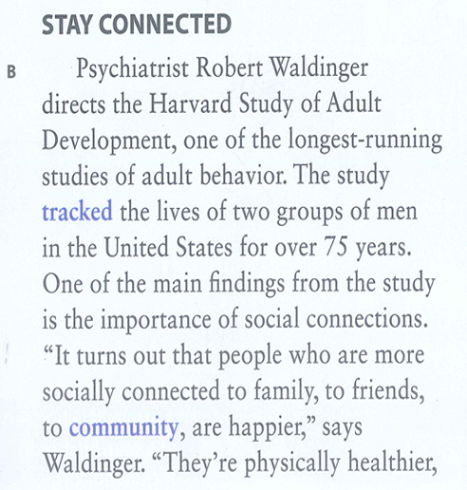
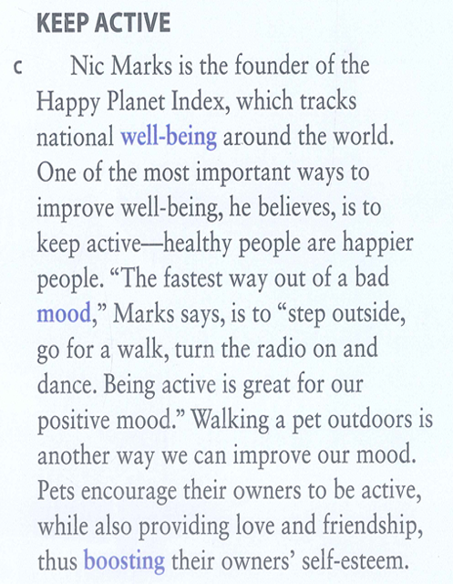
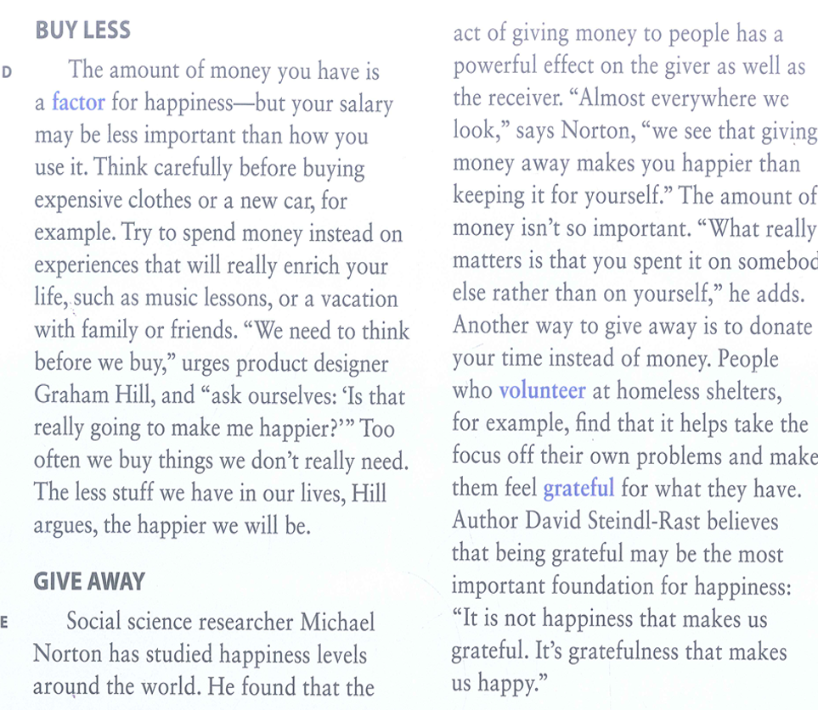
Reading 2 – details

Slide 22
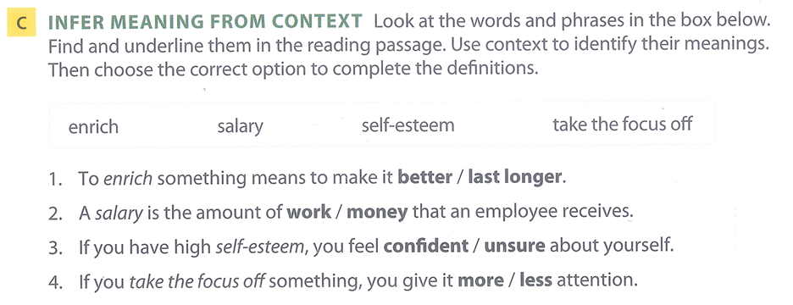
Reading 2 – infer meanings

